Slide 1

Enhancing Blood-borne Virus Screening and Treatment, Harm Reduction and Health Service Delivery for People Deprived of Liberty
Frederick L. Altice, M.D., M.A.
Professor of Medicine and Public Health
Yale University

Slide 2
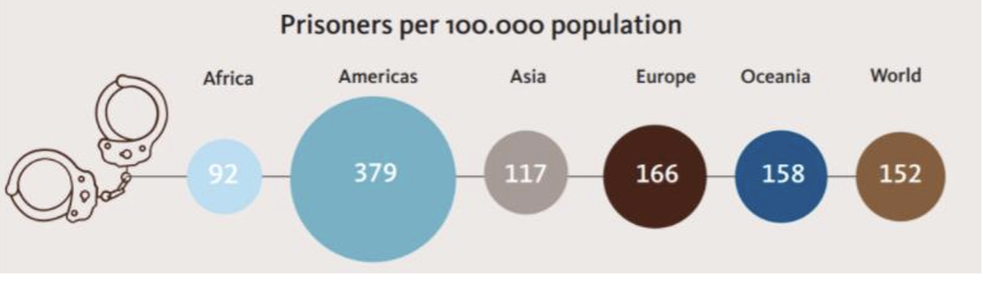
People Deprived of Liberty
PDL per 100,000 population
UNAIDS, 2021
Global HIV prevalence: 4.4%¹
  Six-fold higher than in the community
  Higher among women than men
Global HCV prevalence: 17.7% (15.0-20.7%)²
  Highest in Australia (28.4%) and Europe (25.1%)
UNAIDS, 2021; Salari, Arch Virol, 2022

Slide 3

HIV Prevalence in Prisons
6.5%
2%
19.4%
8.4%
1.7%
9.6%
1.7%
6%
3-20%
27%
41.4%
0.2%
4-10%
Dolan, Lancet, 2016

Slide 4
Prevalence of Infectious Diseases in Eastern Europe & Central Asia
22-fold higher
19-fold higher
50-fold higher
Altice, Lancet, 2016
Notes:
ADDED the CIRCLE to Syphilis

Slide 5

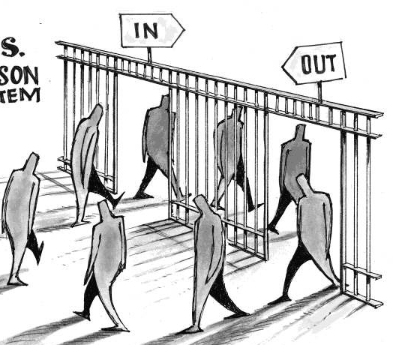
1
2
Amplification
Deterioration
Concentration
Prison Environment
3
Laws and policing selects members with poor health status and/or at risk for HIV, TB, or viral hepatitis
In
High risk behaviors, new social networks, transmission to new community members
Out
Community
Dissemination
Post-Release
Morbidity and Mortality
5
4
Kamarulzaman, Lancet, 2016

Slide 6
Heuristic for Service Delivery with Justice-Involved Persons
Police Lock-up
Pre-Trial Detention
Prison Transfers
Community
Prisons
Transitions are Dangerous
Community Supervision
Community Supervision
See: Bromberg DJ, PLoS Global Health (2023), Aligning Public Health and Public Safety: Probation as a Touchpoint to Identify and Link Patients with Opioid Use Disorder to Opioid Agonist Treatment

Slide 7

HIV/HCV Prevention & Treatment Toolkit
Decarcerate
Decriminalization
Continuity after release
Continuity after release
ART
OAT
PrEP
SSPs
DAAs
DCRs

Slide 8
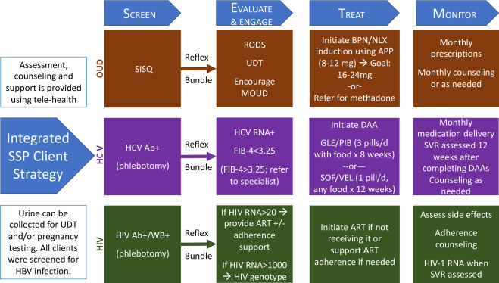
2023: Treatment is NOT Complex
Sivakumar A etal, IJDP, 2022

Slide 9
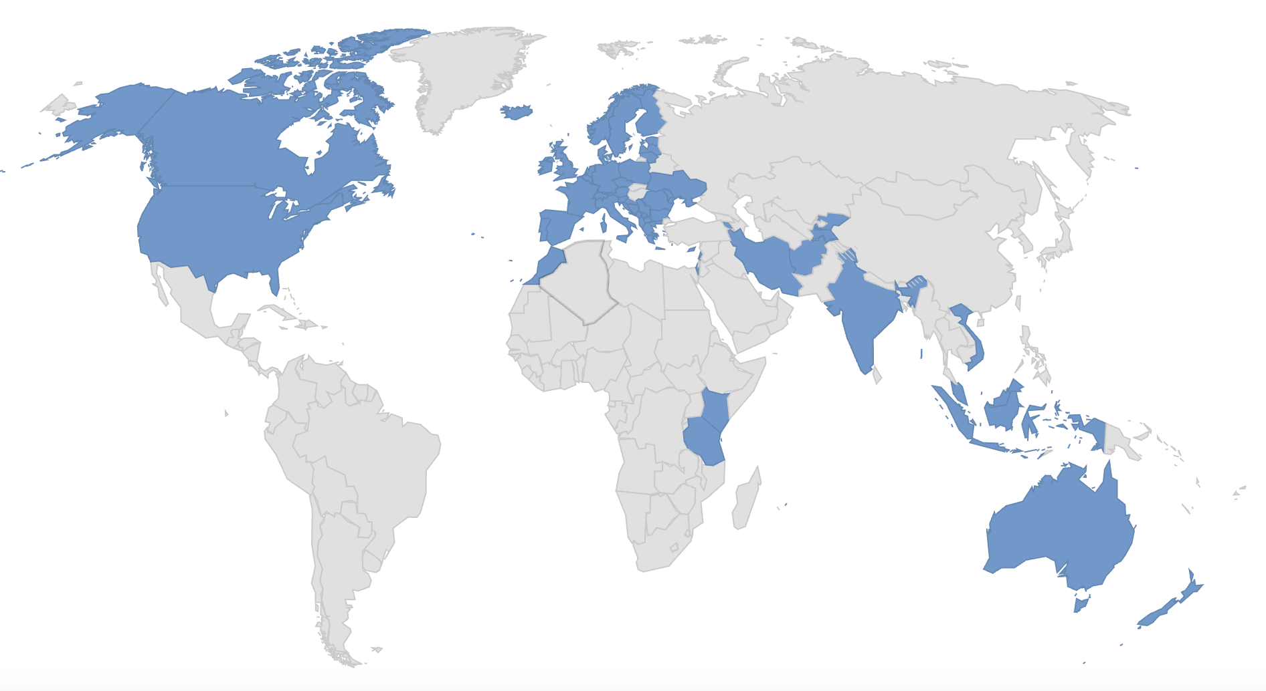
OAT in Prisons (N=59)
Harm Reduction International 2022

Slide 10
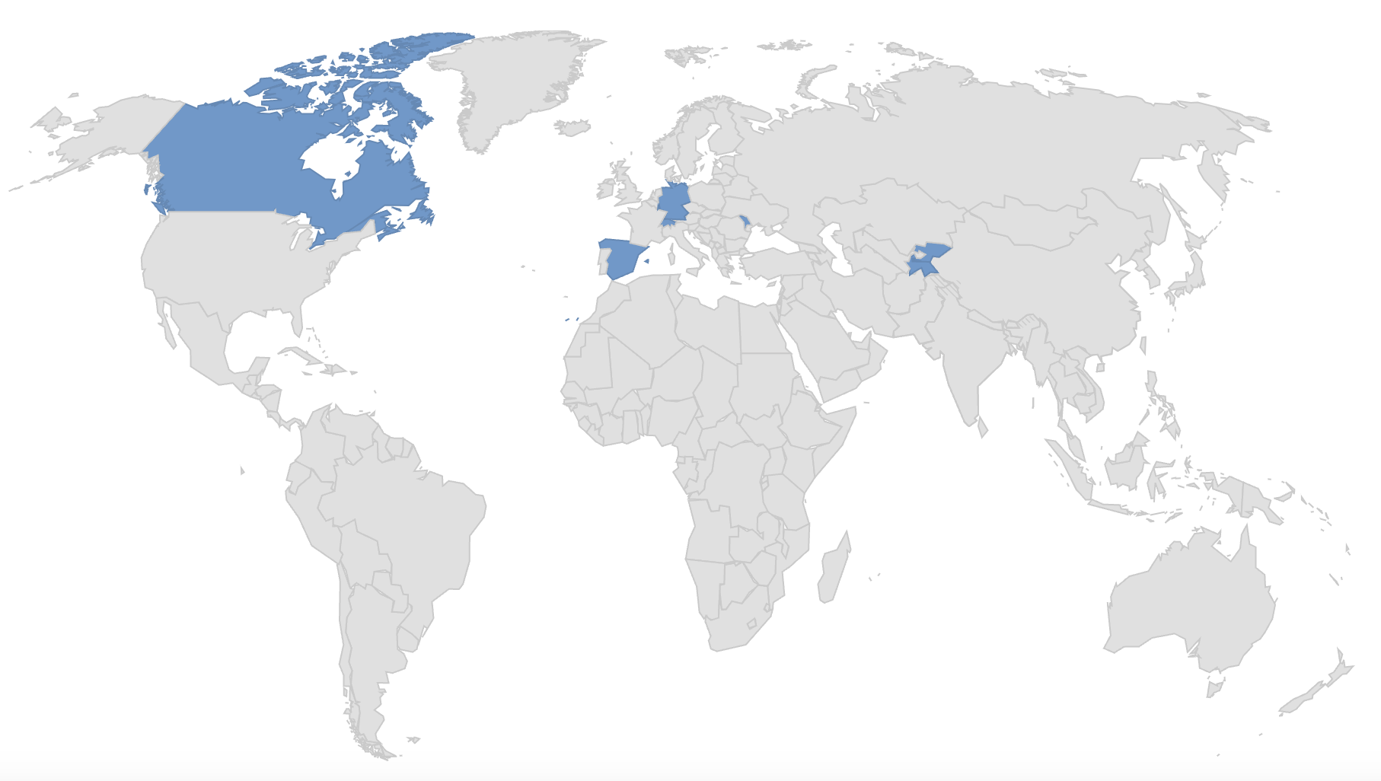
Countries with a SSP in Prison (N=9)

Slide 11

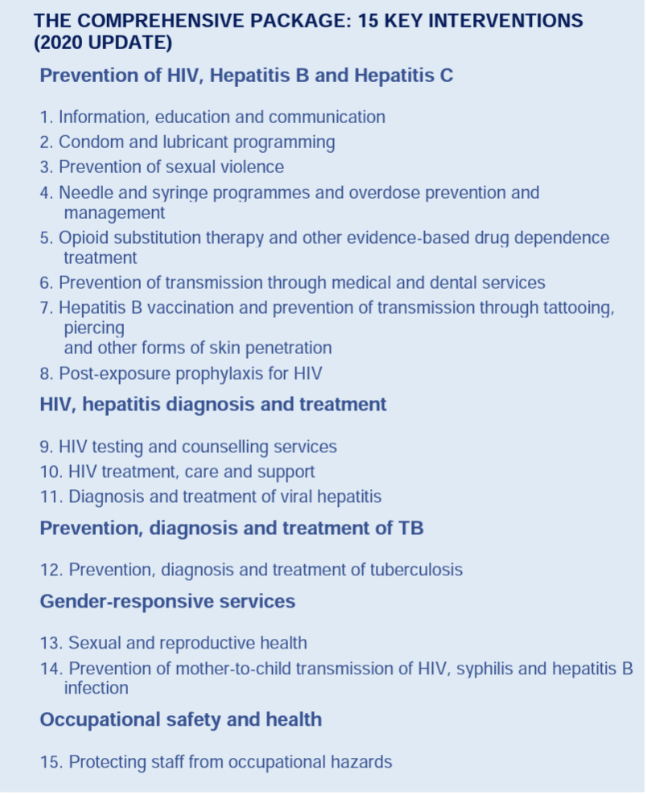
We Know What to Do!
… but HOW do we do it and how do we do it BETTER!

Slide 12
Governing Principles for Implementation
Simple
Cheaper
Faster

Slide 13
Cascade for Treating Comorbid Conditions (SUD-HIV-HCV-SMI)
Screen
Routine*
Bundle*
Evaluate
Motivate
Treat
Clinically Improved?
Transition

Slide 14
Socio-Ecological Model for Understanding Barriers & Facilitators
Structural
Custody
Clinicians
PDL
Custody Leadership

Slide 15
Implementation: Process Improvement
People
Executive Sponsor
Change Leader
Change Team
Change
Tools
Conduct walk-through
Flow-charting
Nominal group technique - barriers
PDSA/Rapid cycle testing
Aim
Project
Rules
Use existing resources→ task shift
Measure change objectively
Sustain the gains
Five Principles
Understand/Involve the customer
Fix Key Problems
Choose a Powerful Change Leader
Get Ideas from Outside the Organization
Use Rapid-Cycle Testing

Slide 16
Barriers to OAT
Patient
  Negative attitudes toward OAT (misperceptions)
  Stigma/Discrimination (other PDL / custody)
  Too burdensome
Other PDLs
  Informal prison hierarchy
Medical Staff
  Lack of addiction and HIV experts
  Too busy / too complicated
Custodial Staff
  Safety of movement
  Negative attitudes

Slide 17
Screen-Evaluate-Treat (SET) Strategy for Scaling Up OAT in Ukrainian Prisons
Methadone introduced as a pilot project in a single prison in late 2019**
  Volunteer – Rigorous Evaluation – Treatment
Two-site implementation plan (first time and recidivist prisons) – all PDL screened including new arrivals
  Single-item screening → RODS for diagnosis → Brief Intervention → Brief telemedicine evaluation (co-screening for HIV/HCV) → Treatment initiation
  Brief intervention → modest increase in interest
  Time from screening to treatment (19 → 5 days)

Slide 18
Implementation Outcomes
Other opportunities:
30 new HIV cases
148 HCV Ab+
Process improvements:
Re-assess for interest (+9)
Implementation Gap (-64.3%)
100%
40.3%
35.7%

Slide 19
Flow Chart of Activities for Methadone
MD Assess Risk (HIV, HCV, OUD) – 30 min
Laboratory Testing
Confirm diagnosis by Narcologist (T)
Screen for HIV and HCV (and TB)
Physician observation daily
Initiate Treatment
Psychological Counseling & Motivation
Review
Results by MD

Slide 20
Revised Flow Chart of Activities
SISQ
Telemedicine with Narcologist
Brief Motivation → Decision aid
Laboratory Testing
If (+) → RODS to confirm (8 items)
Initiate Treatment
Nursing Dispensation & Checklist

Slide 21
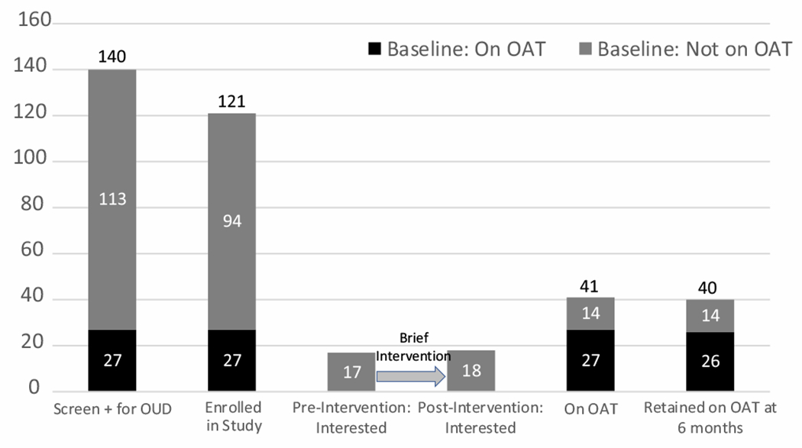
Pilot Study of Screening and Treatment Before Release from Prison (Moldova)
Implementation gap: 66%
Process Changes
Decision aid
Hierarchy
Post-release reassessment
34%
Dorgay C, IJDP, 2022

Slide 22
Methadone Dose at the Time of Release Predicts Treatment Retention
N=192
(N=77)
(N=115)
Ahmad A et al, IDJP, under revision

Slide 23
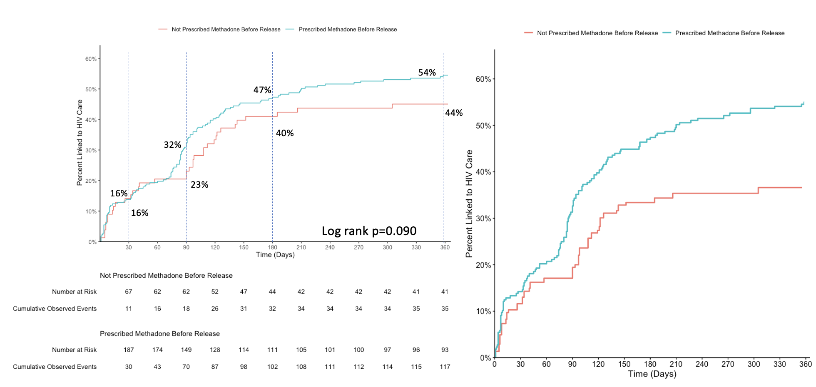
Methadone Prescribed in Prison Predicts Linkage to HIV Care for PDL with HIV and OUD
N=296
Methadone (N=218)
No Methadone (N=78)
33%
16%

Slide 24

Screening should be universal and bundled, followed by evaluation/engagement, treatment and continuity post-release
  Comorbid conditions are common in PDL
  Better treatment → decarceration (decriminalization)
Guidelines should be a “living” document that change by process improvement strategies for real-time and more effective implementation
Care is “mostly” simplified for HIV/HCV/OUD
  Telemedicine
  Project ECHO

Slide 25

McPrison
12 Million Sentenced!
12 Million Sentences Served!
McPrison
Sentenced
Released

